Slide 1


LANL Team Project Update
3/24/2025
Izzy Baumler, Dalton Boeckmann, Morgan Gullo, Jade Waldron

Slide 2
Problem Statement/Project Motivation
There is a need for a technology that has 5 DOF and can move through its full range of motion in each degree of freedom of at least 1 Hz.

Slide 3
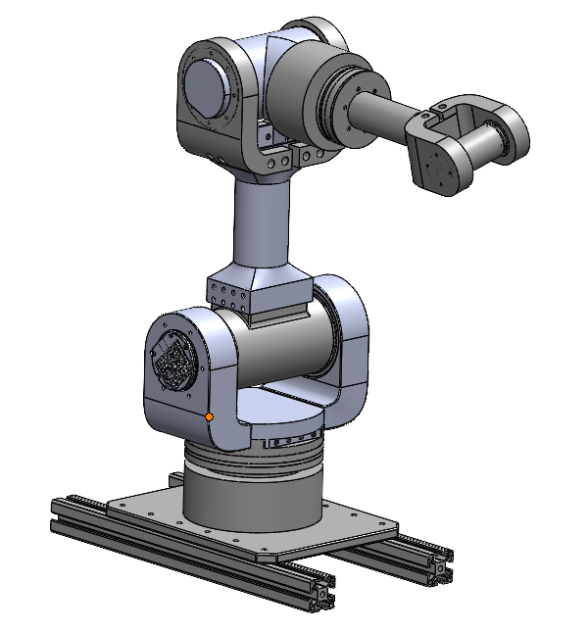
Weekly Assigned Tasks
Jade - Solidworks Refinement/Prototyping/Assembly
Izzy - Motor Research and testing
Dalton - Assembly/Motor Testing
Morgan - Purchase Orders/Electrical

Slide 4
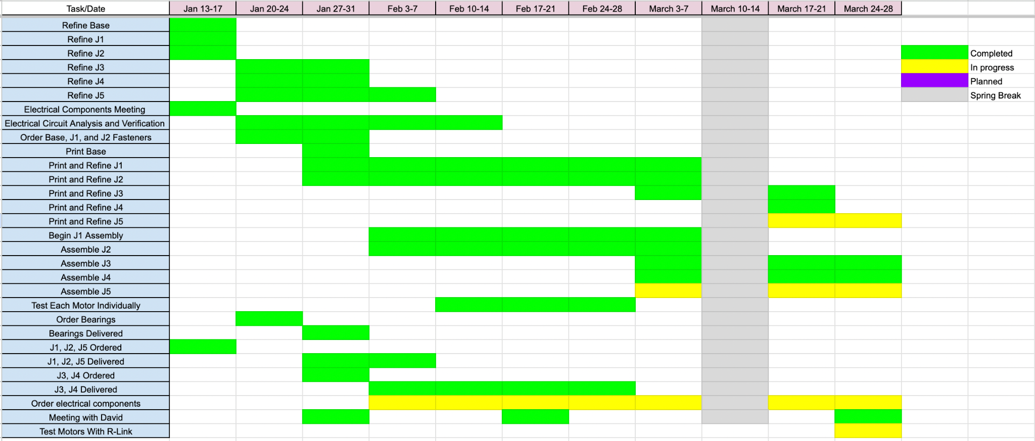
Schedule Update

Slide 5
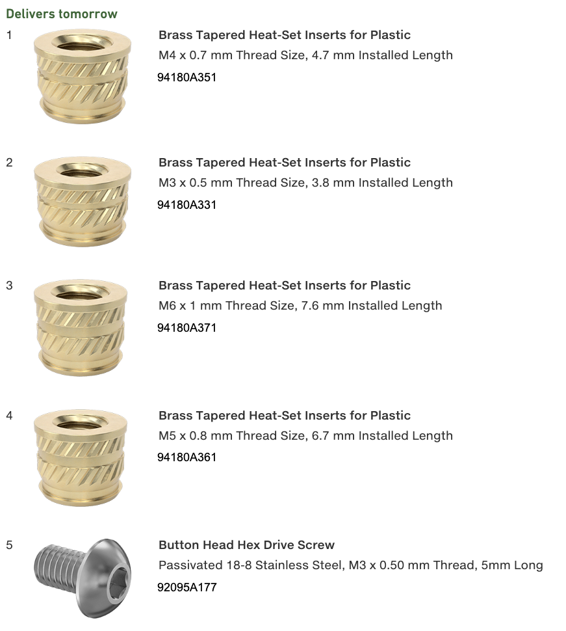
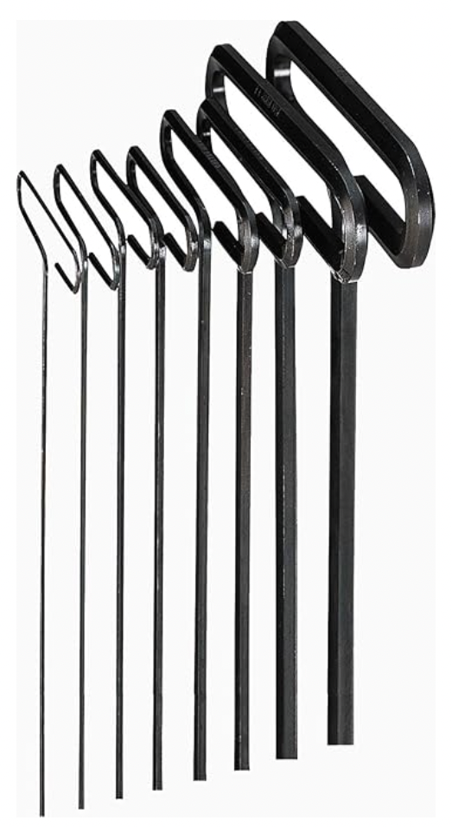
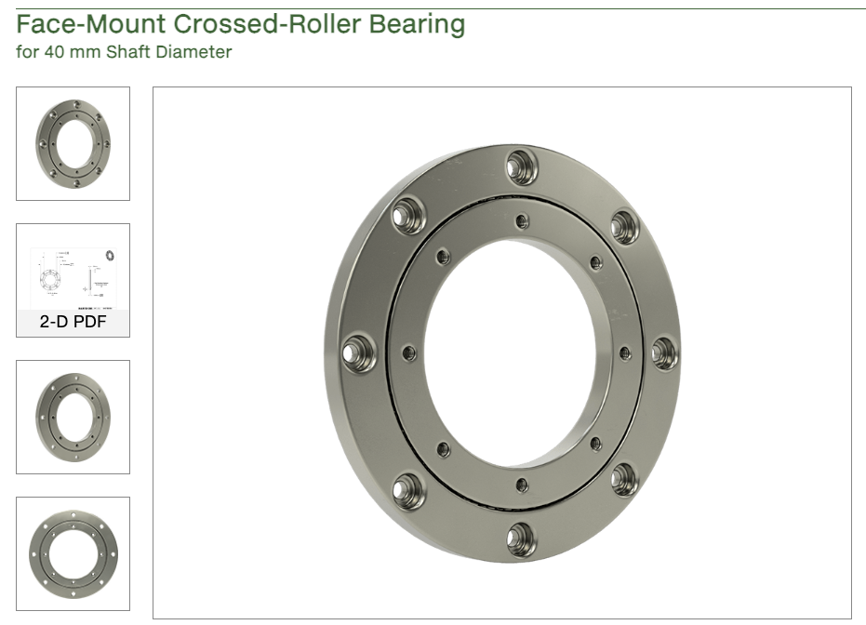
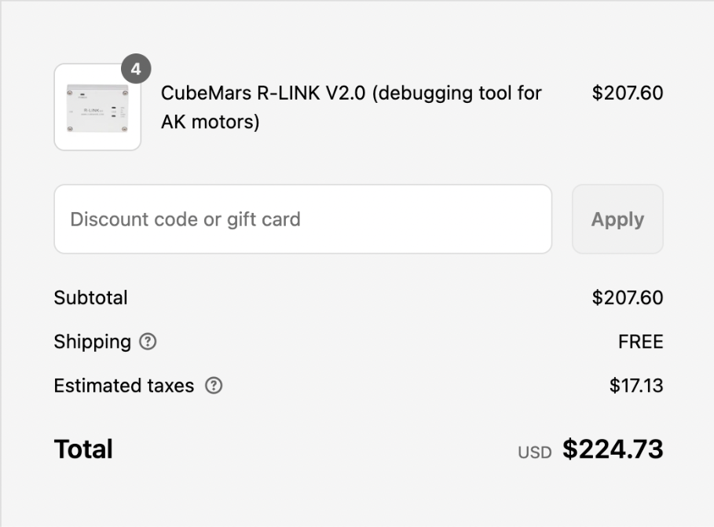
Orders Update
All r-links delivered
Extended allen wrenches
Additional Heat-Set Inserts and Fasteners
New J4 Bearing

Slide 6
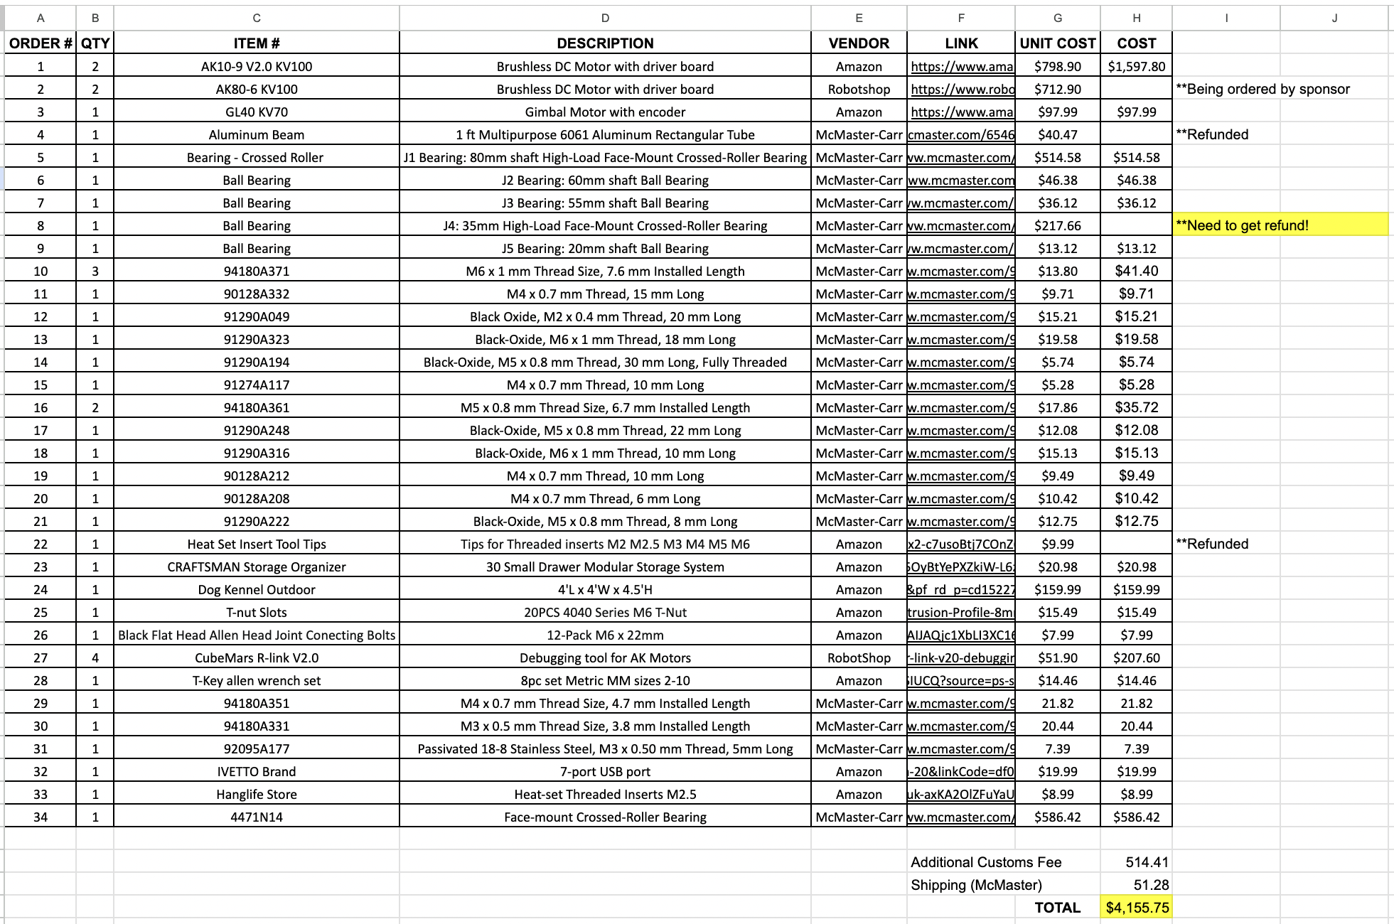
Budget Update

Slide 7
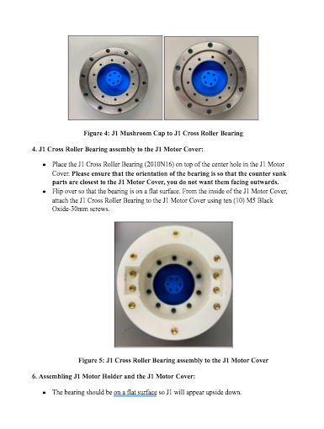
Assembly Manual
Assembly Manual for Base, J1, and J2 descriptions are finalized
Base and J1 Assembly Figures Added and Finalized
J2 figures need to be added

Slide 8
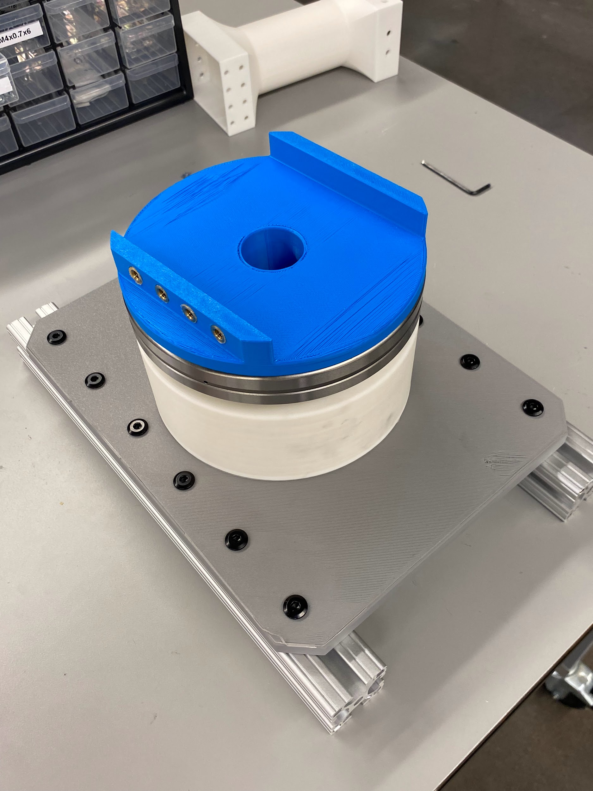
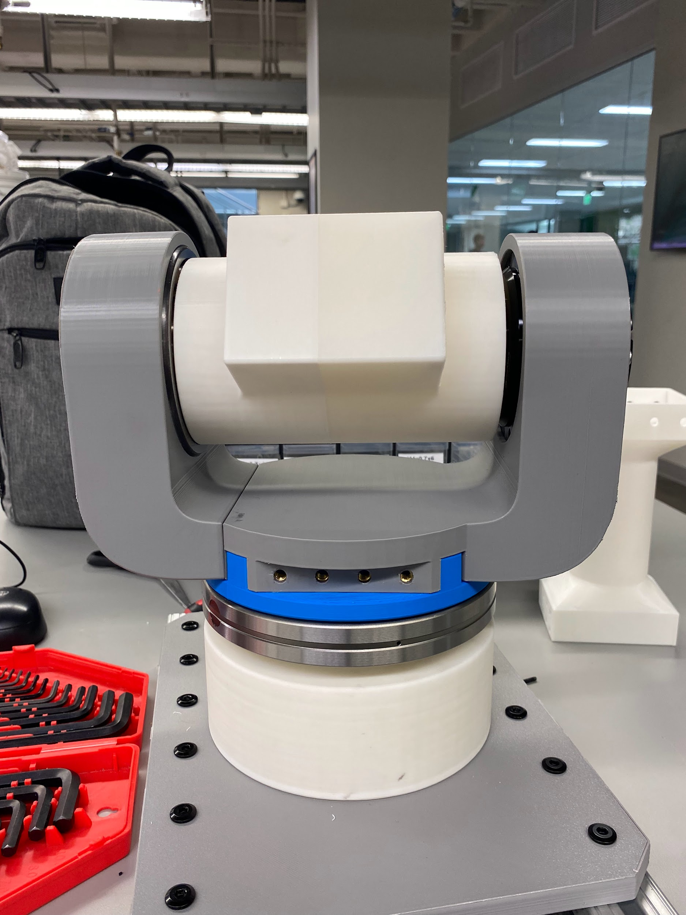
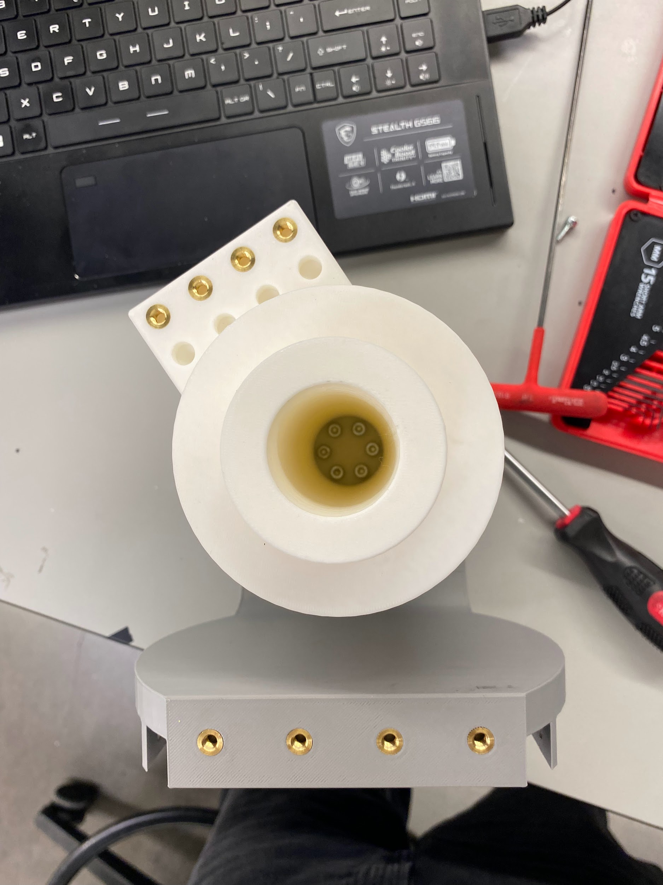
Prototyping/Assembly

Slide 9
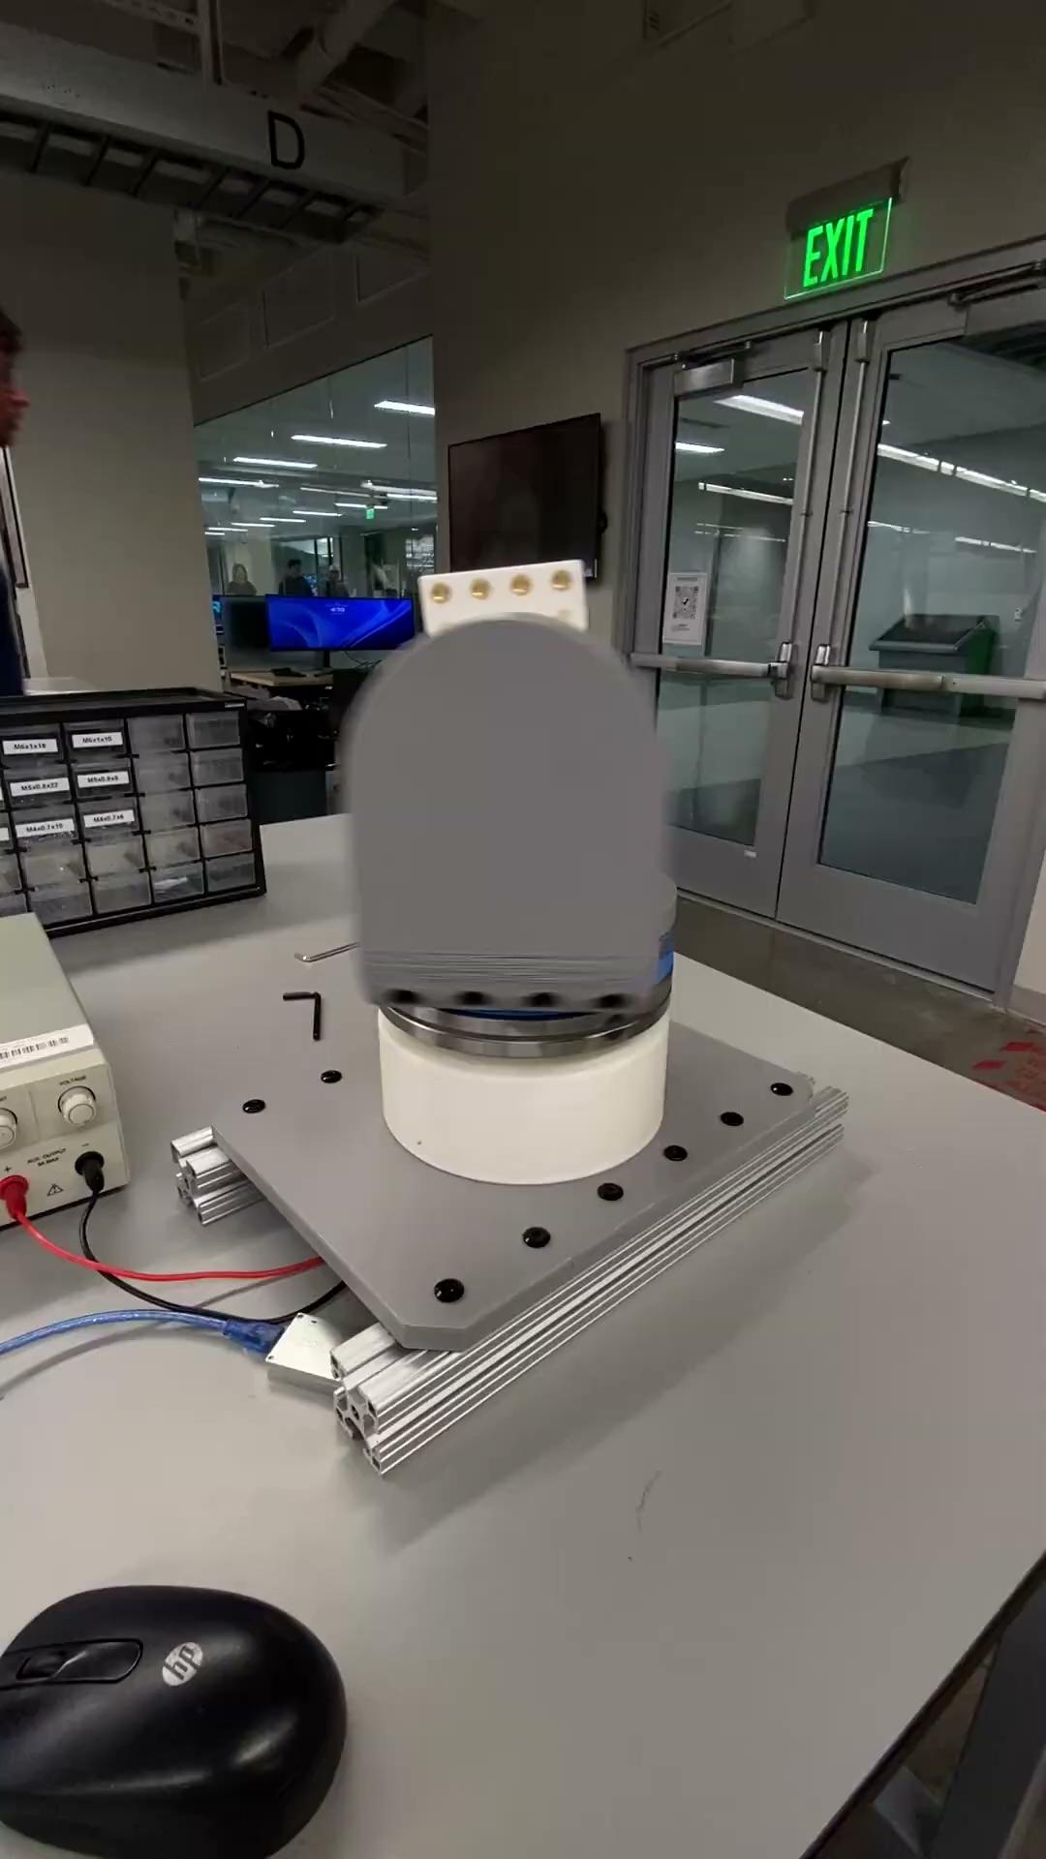
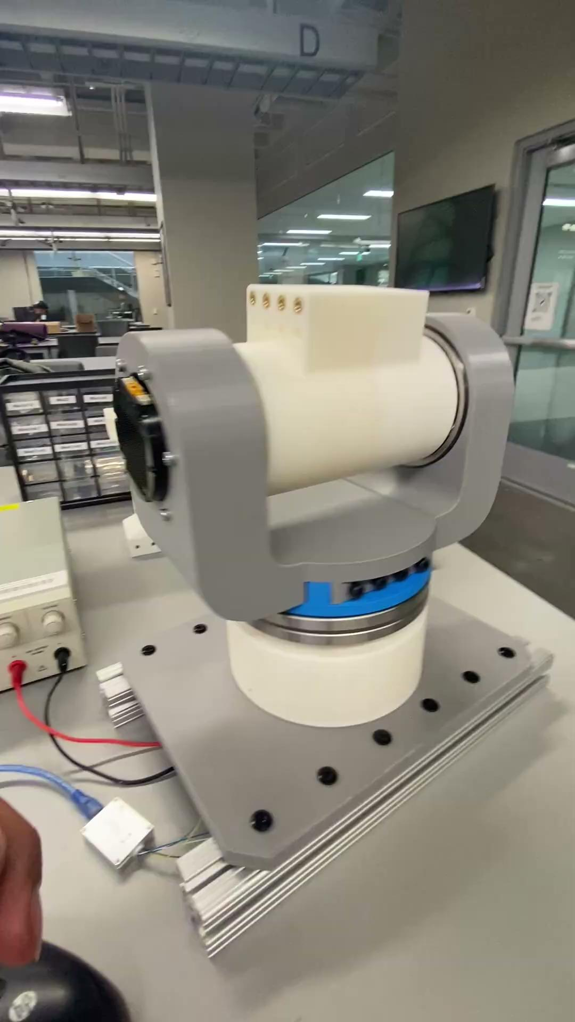
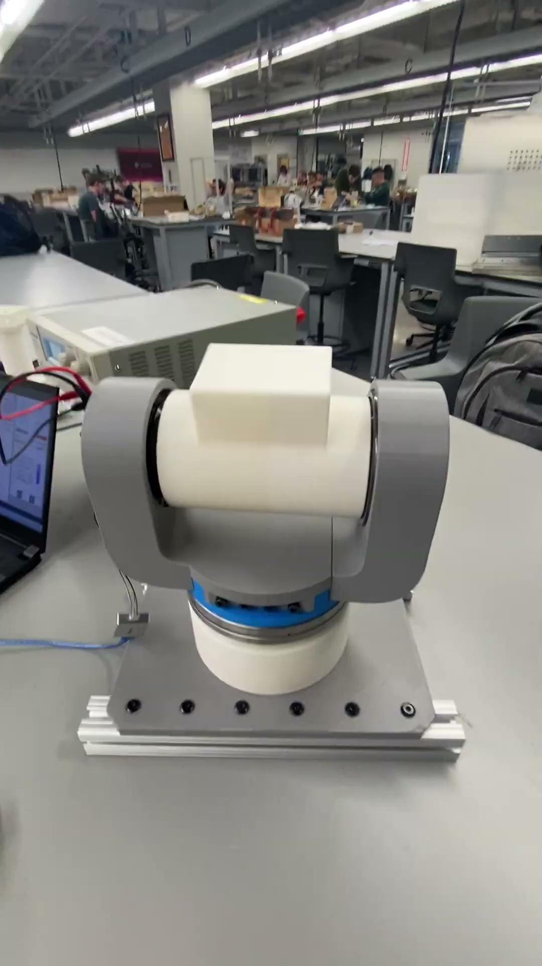
J1 and J2 Operation

Slide 10
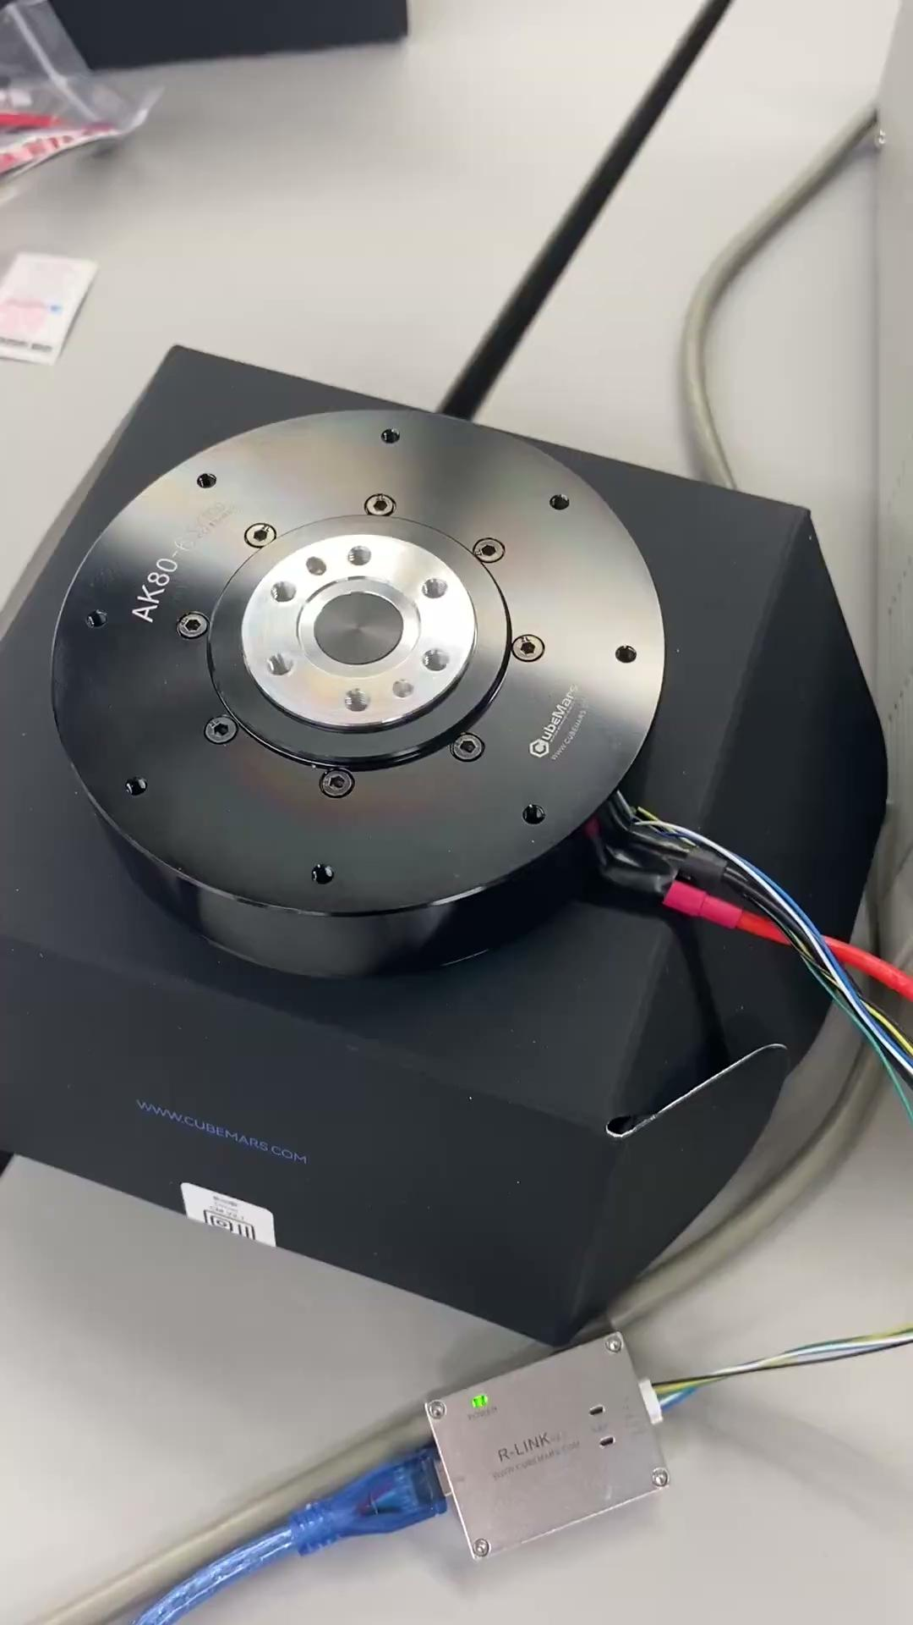
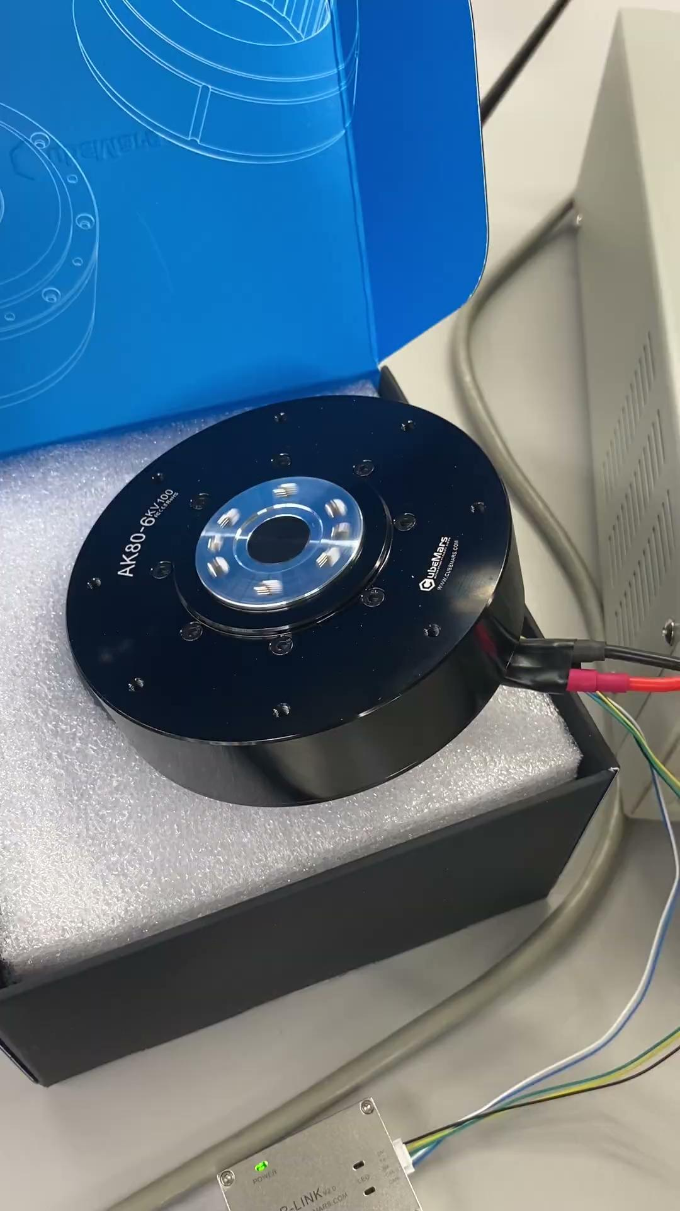
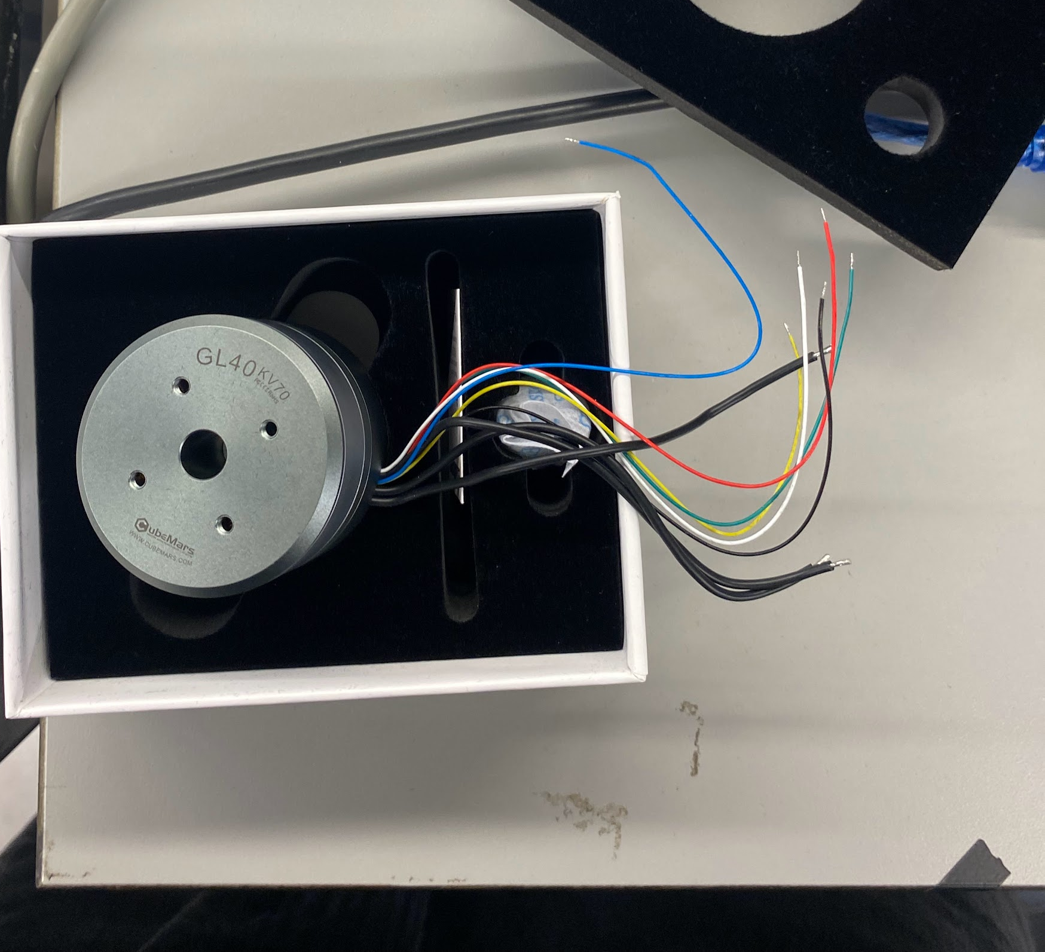
J3, J4, and J5 Motor Verification
Will need to solder these to the allocated R-Link connection

Slide 11
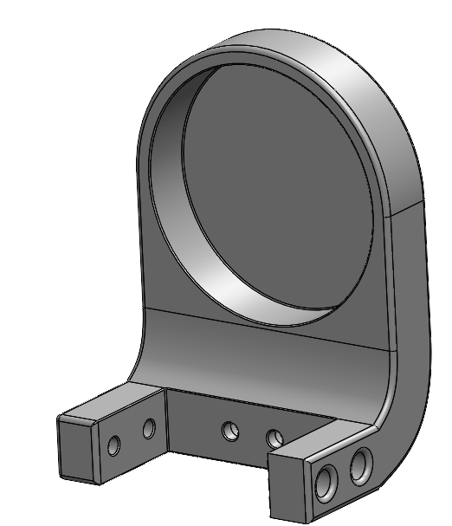
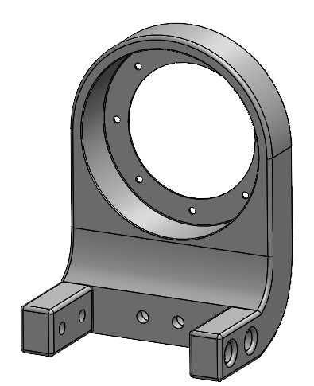
Refinement/Prototyping
J3 Motor Holder
J3 Bearing Holder

Slide 12
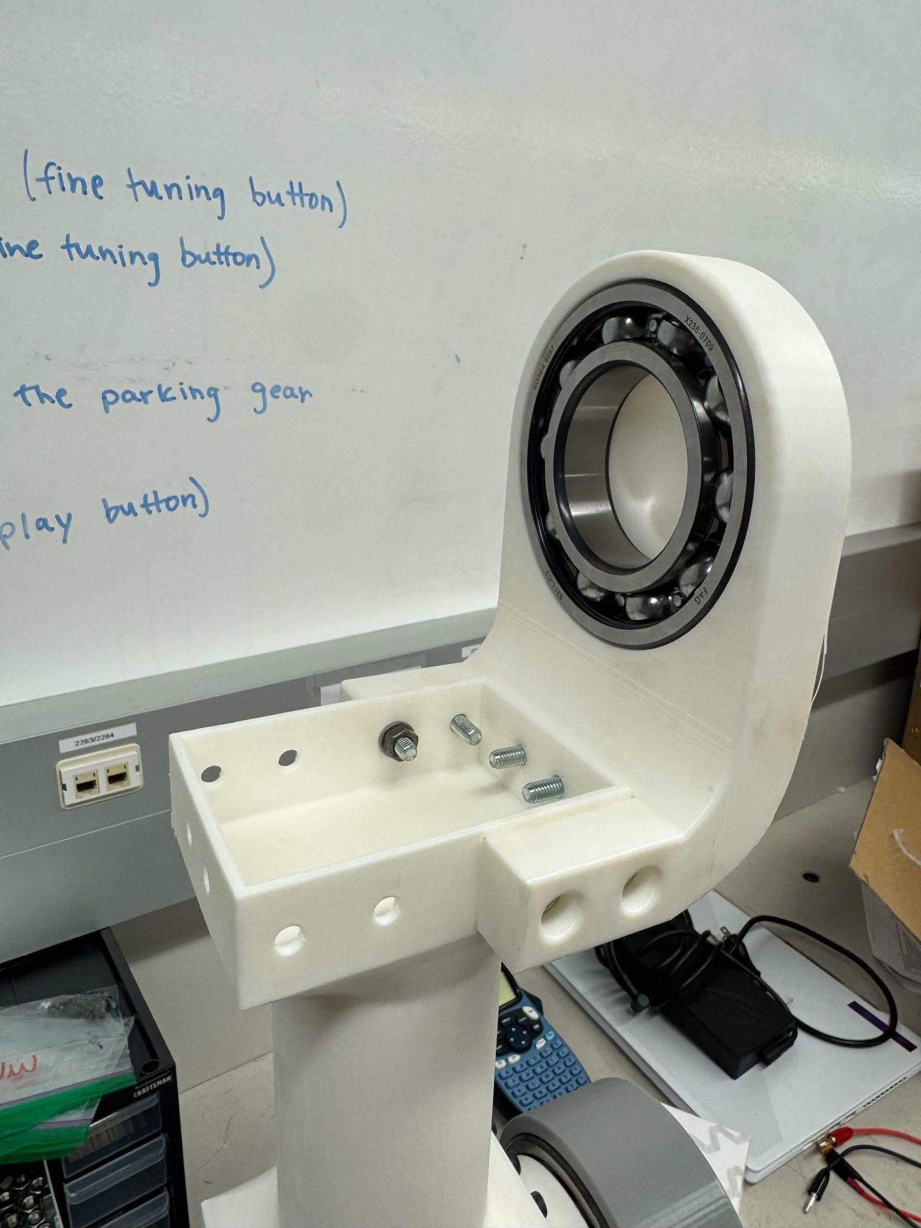
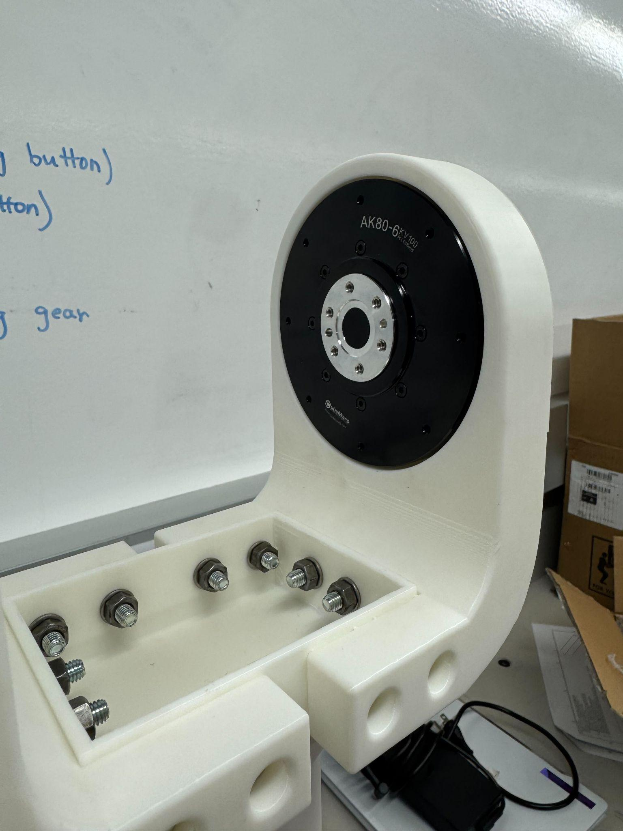
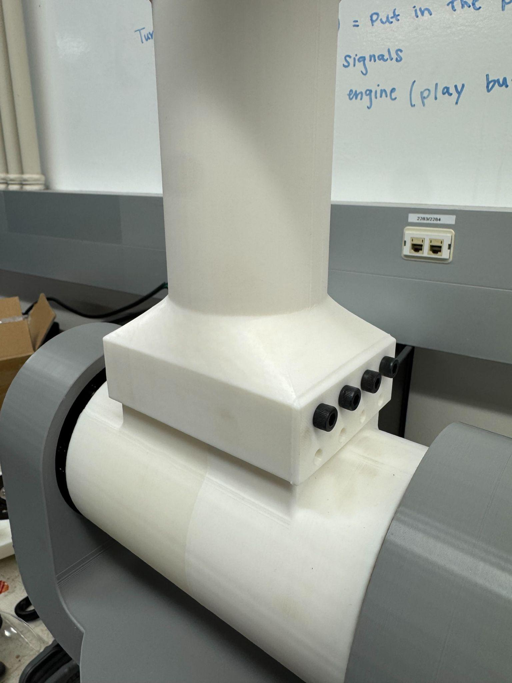
Prototyping/Assembly - J3

Slide 13
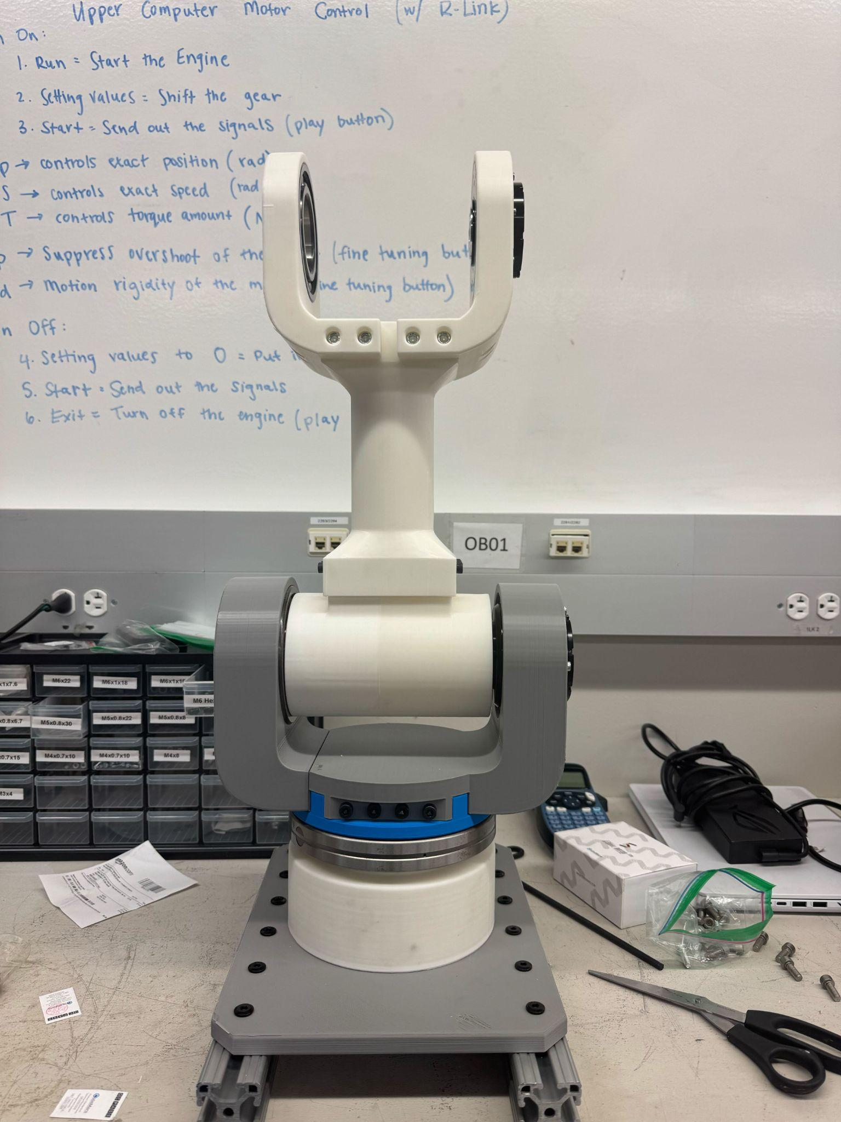
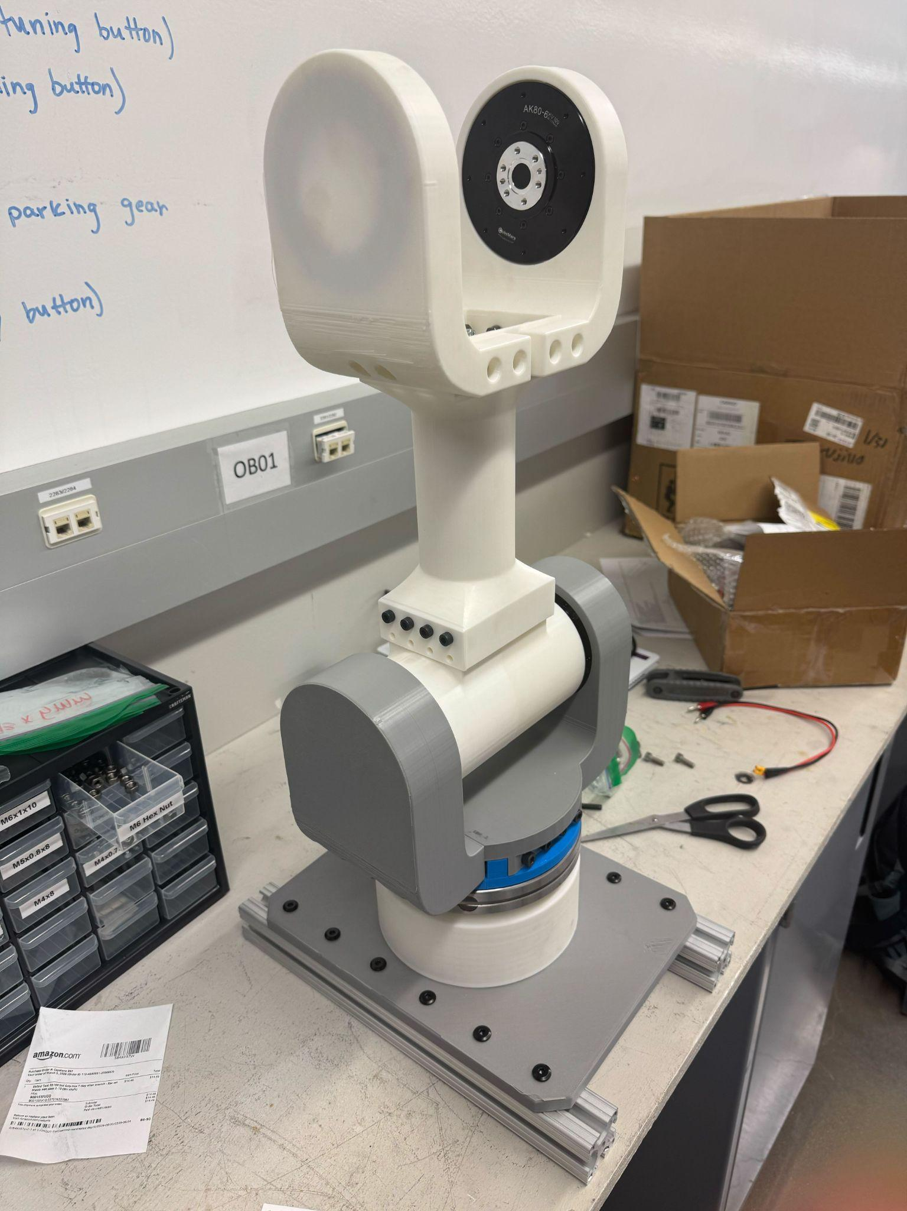
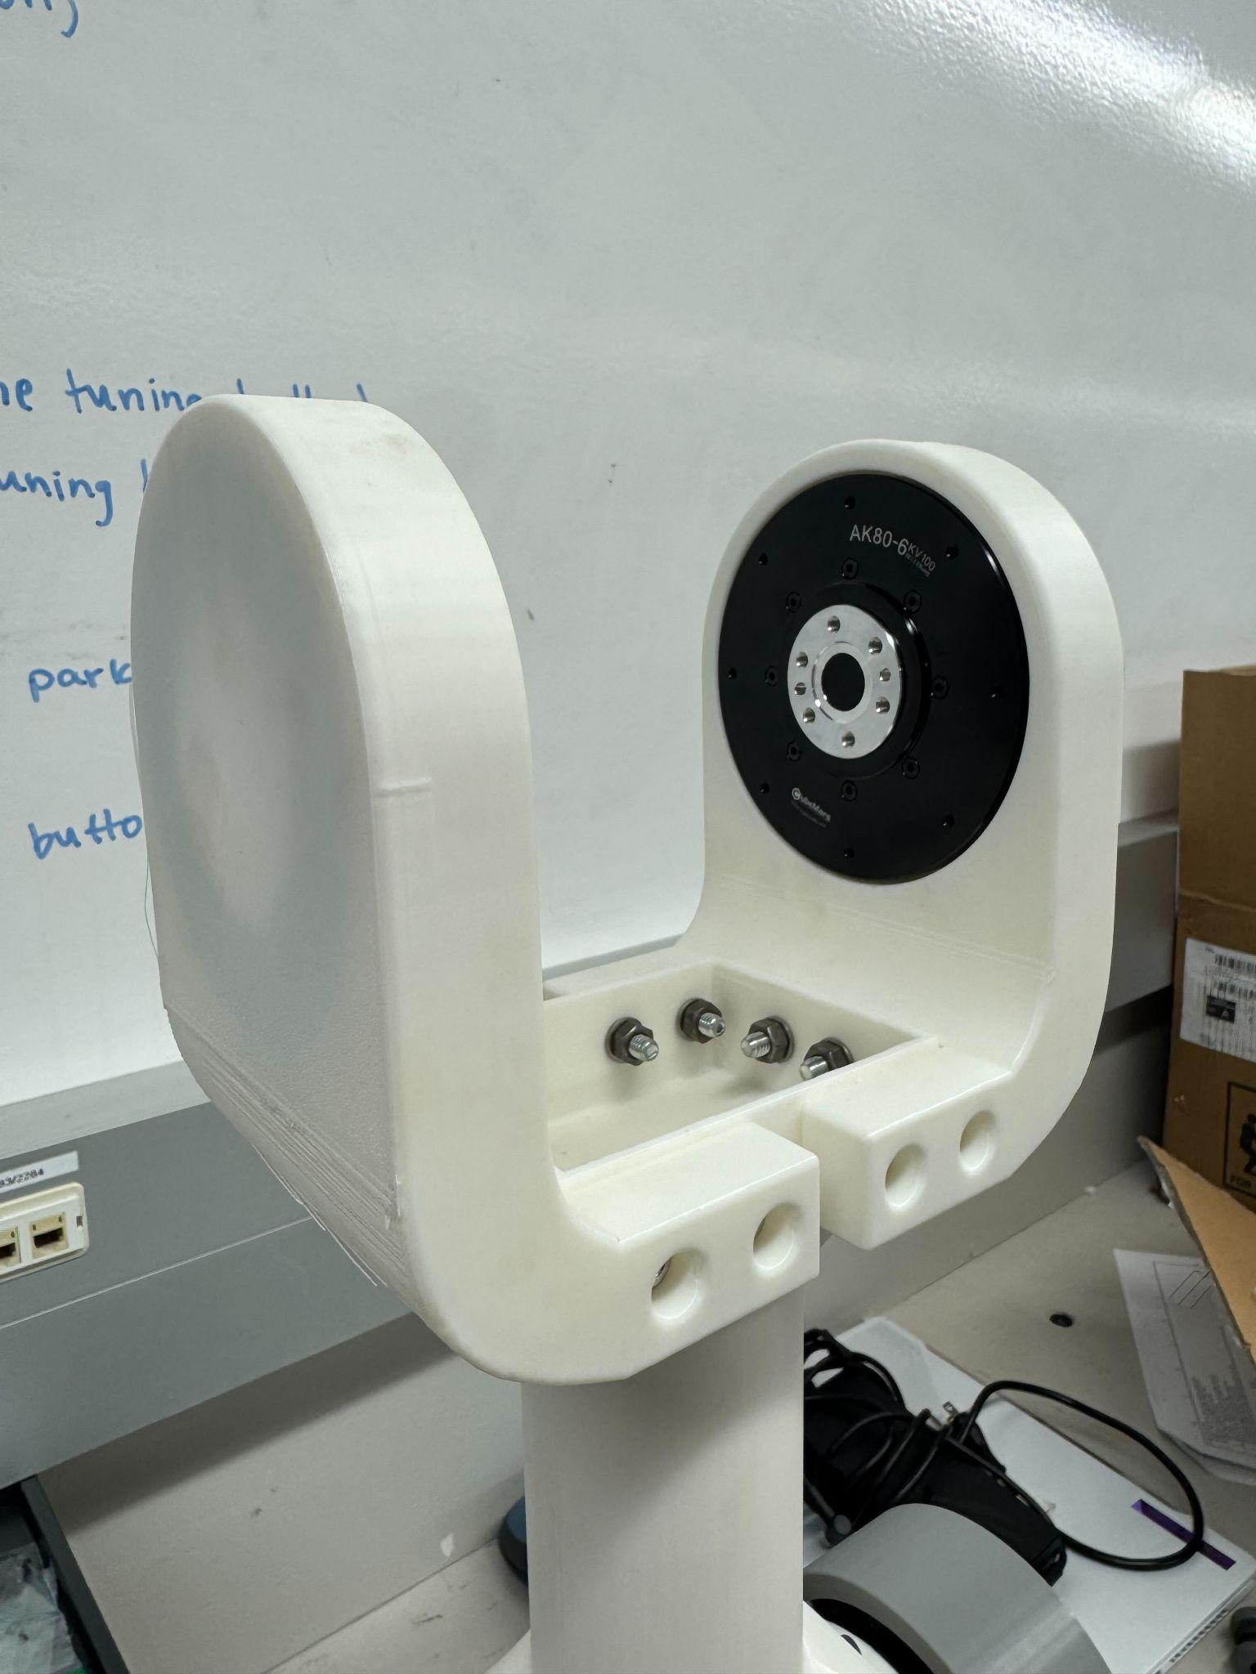
Prototyping/Assembly

Slide 14
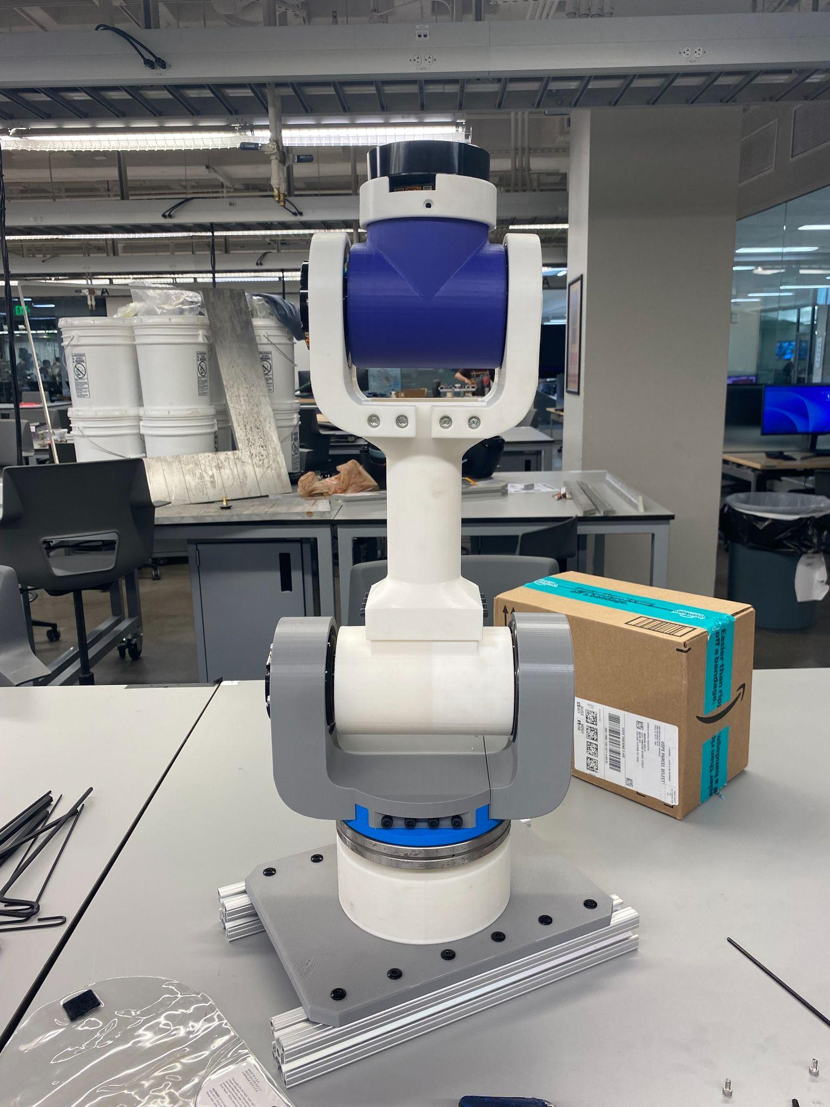
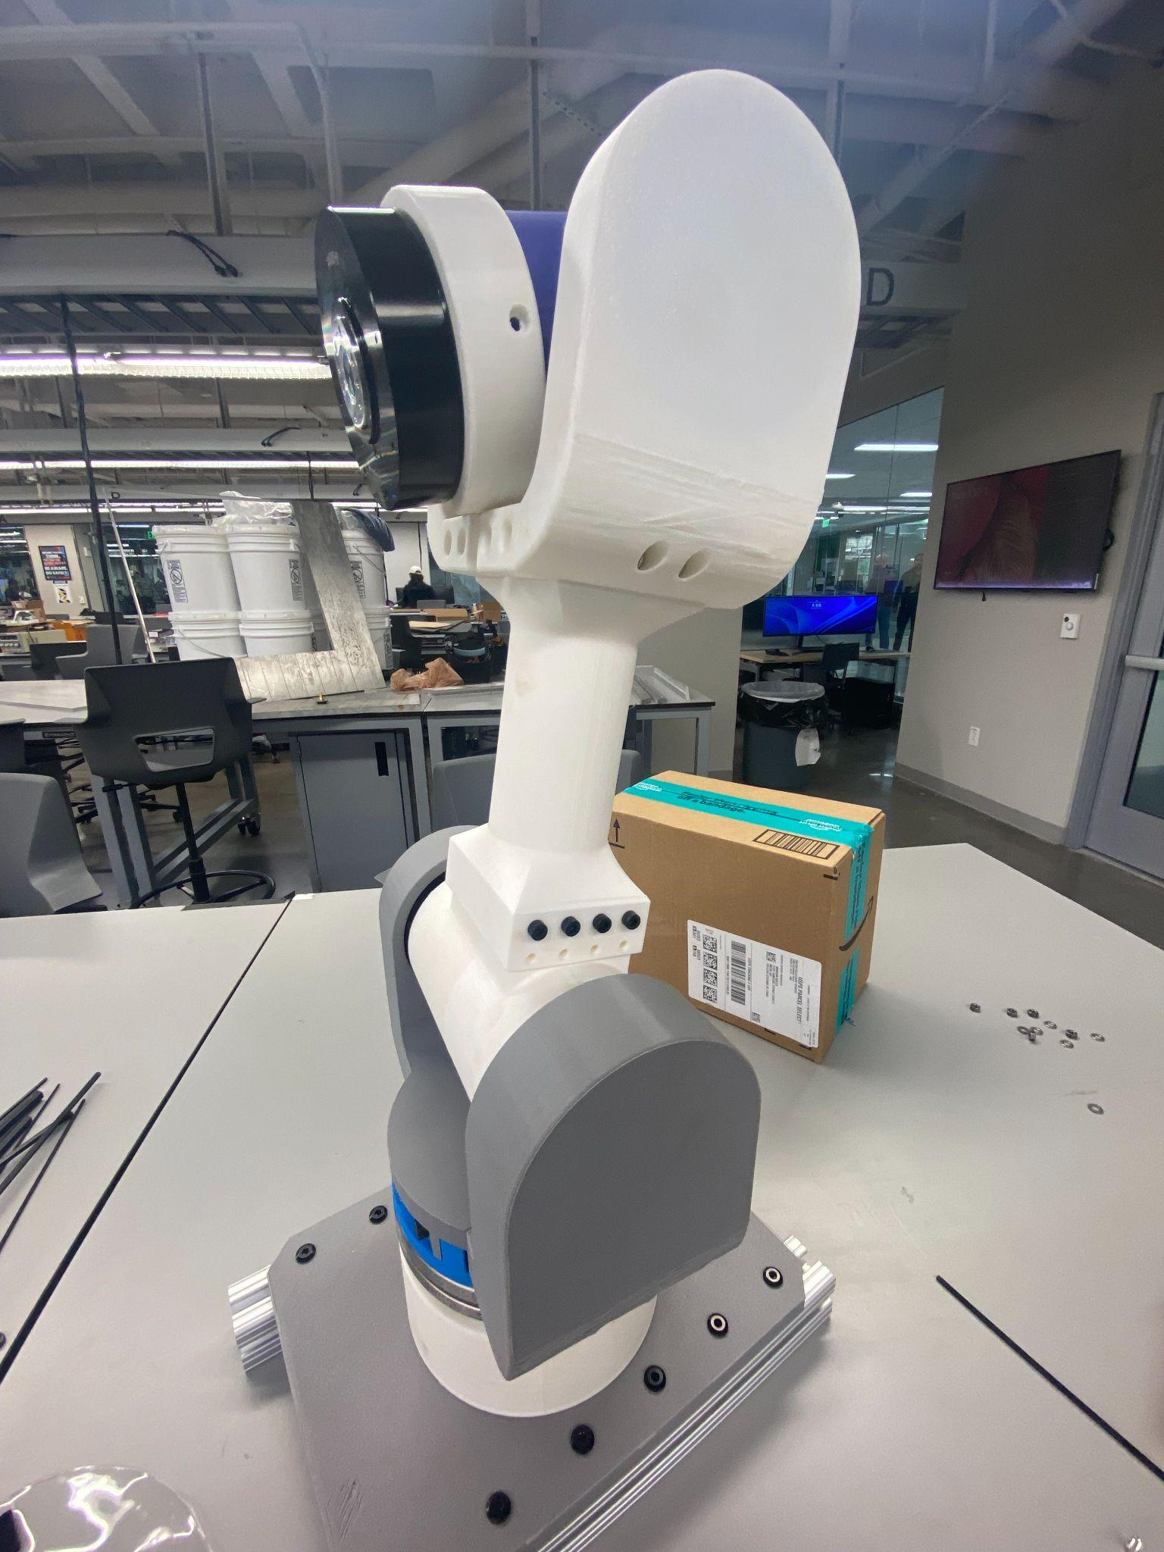
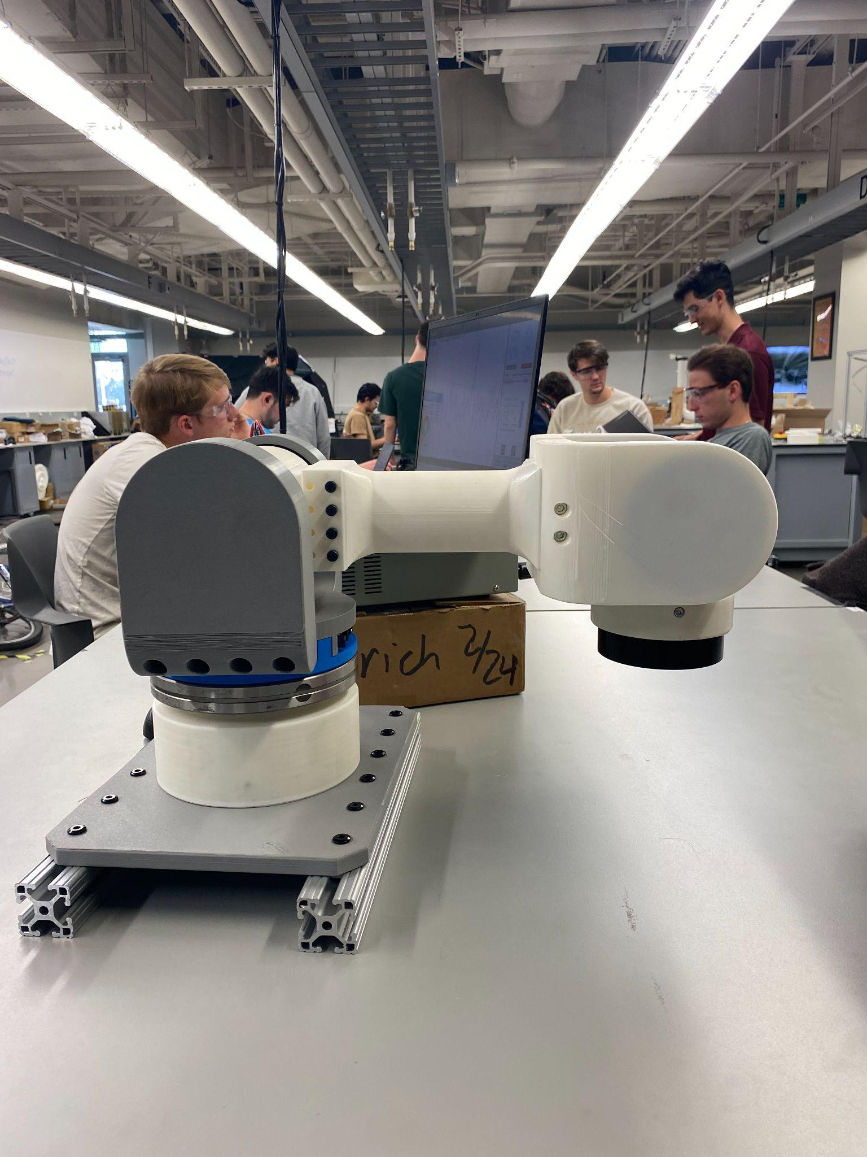
Prototyping/Assembly

Slide 15
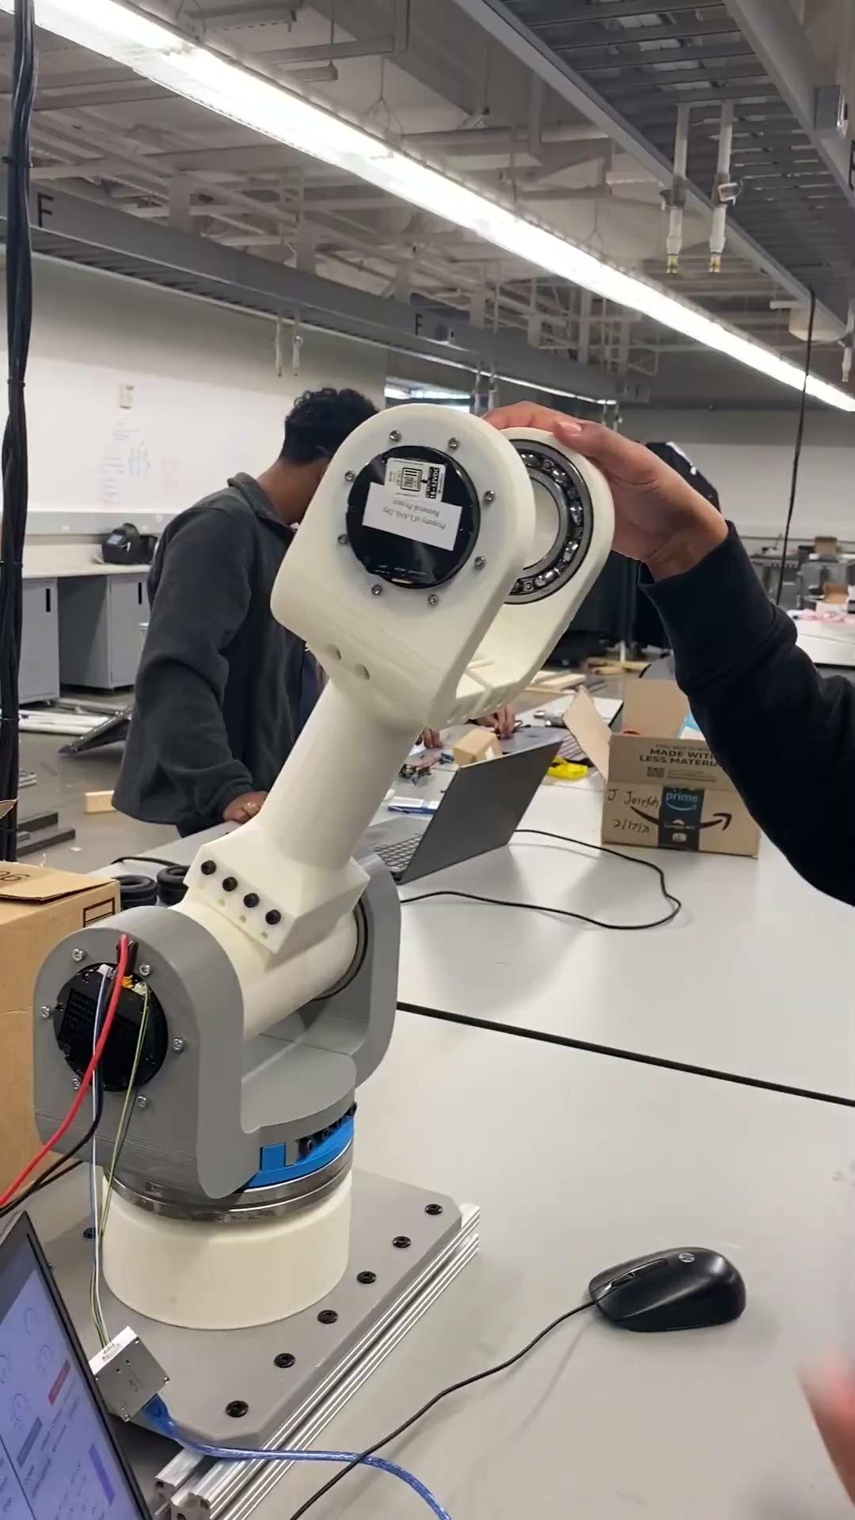
Torque Control
Torque Control For Robot Holding itself up at max Extension for J2
Upper Computer
T - 8 Nm
Kp - 3
Kd - 1
Problem with Torque loading when the robot arm is rotated

Slide 16
Servo Mode Control
Problem with Torque loading when the robot arm is rotated
Solved under servo mode operation
Servo Mode operates at max speed in position loop control
Our team will stay in the Position, Speed, and Acceleration control to ensure safety - Servo Mode

Slide 17
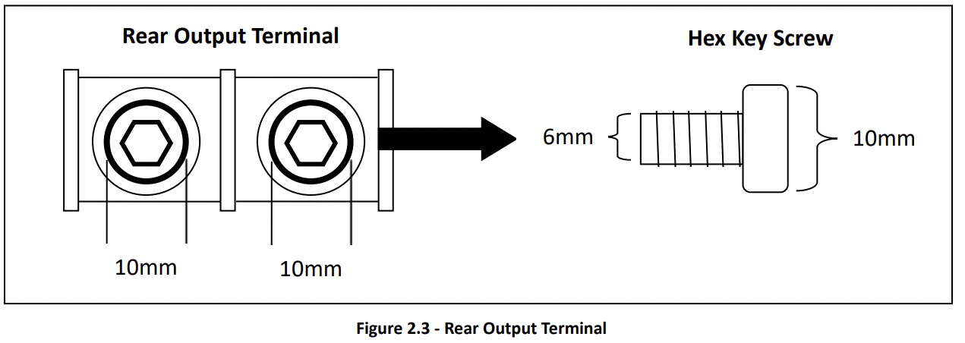
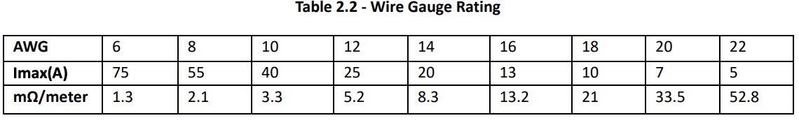
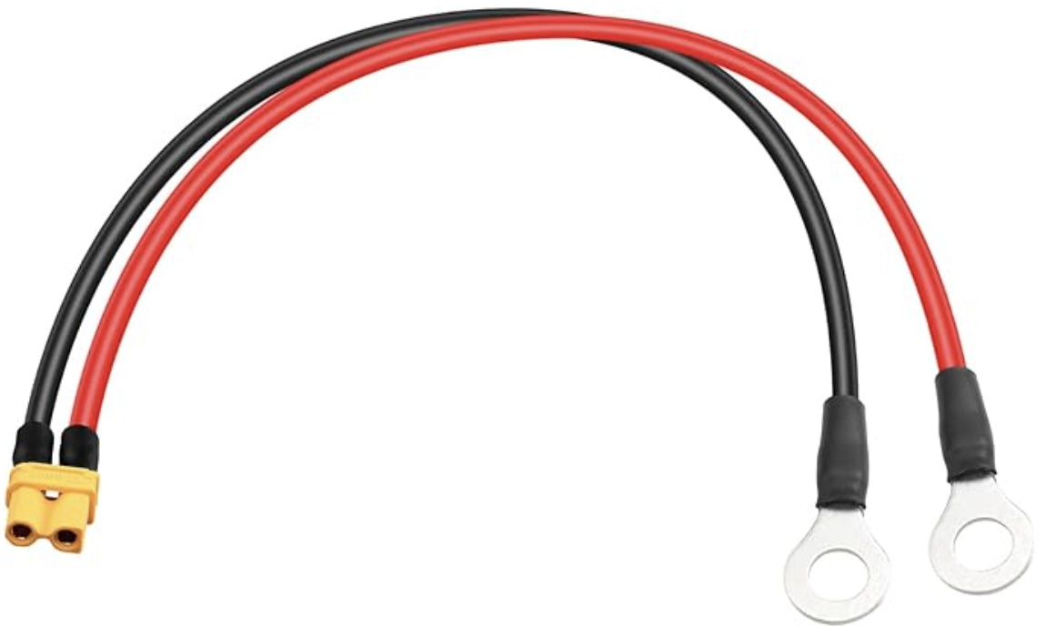
Power Supply Research
Power supply output terminal is provided with M6 socket head bolts to connect to M6 ring terminals
Need to determine wire gauge rating and length of wire to connect to power supply and each corresponding motor
J1-J4 motors will be connected to provided power supply with 24V and J5 will be connected with additional power supply set to 16V

Slide 18
Wire Management
Components need to stay connected as robot rotates 360 degrees
Prevent robot from unplugging itself
Wires will be zip tied and wrapped in braided cable sleeving
Overall connection structure:
Connect each motor with an R-link
Each R-link is connected to the computer through a 10 ft USB cord
Connected to a laptop through a 5 port USB hub

Slide 19
Future Work
Verify electrical components
Assemble J5
Continue Assembly Manual changes and updates
Motor testing once assembled for J4 and J5
30 Day-out Milestone Monday, March 31st with Studio Professor
Final Presentation April 24th 5:00 - 6:00 PM

